Slide 1

‘Stay Alive’ OPIOID overdose prevention program
Esther Djan

Slide 2

CONTENT
Introduction
Why this matters
Key Findings
Intervention Statement
Logic Model Framework
Conclusion
References

Slide 3

INTRODUCTION
Opioid related deaths are caused by opioid drugs. A typical example is when overdoses of heroin contaminated with fentanyl are taken.
It slows or stops breathing ability of an individual.
Naloxone is a fast-acting medication that reverses opioid overdoses and restores breathing within minutes.
Opioid related deaths mostly affect people aged 26-35 years with a higher percentage in male.
The research makes more emphases on people residing in West Virginia, especially at rural deprived areas and homeless people.
The rates of death from opioid related is regarded as an emergency.

Slide 4
Why This matters
Among 422,605 unintentional opioid toxicity deaths in the U.S. between 2011 and 2021, the median age was 39 years and 69.7% were male.
West Virginia is at the center of an avoidable epidemic, with overdose death rates far higher than the national average.
There were 1,335 overdose deaths in West Virginia in 2022, as well as 80.9 overdose deaths per 100,000 people in West Virginia in 2022.
With the age range being affected, Opioid related death is referred to as the ‘youth killer’ and so must be looked at and attended to with all seriousness.
Opioid related death is preventable and so requires urgent action.

Slide 5
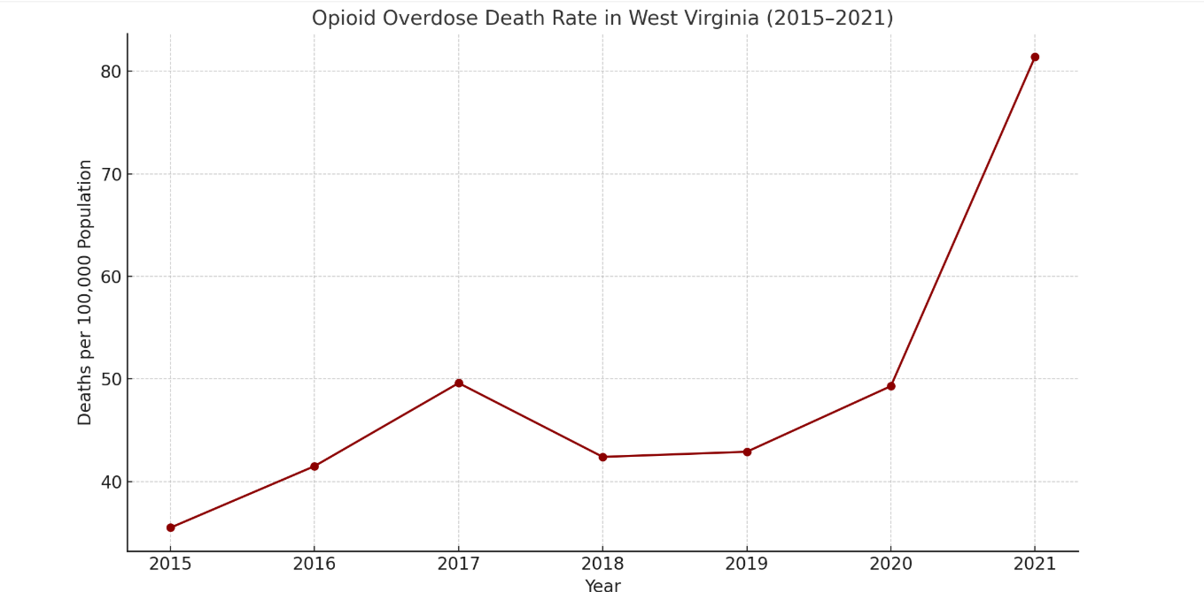

KEY FINDINGS
The increasing rate from year-to-year is outraging.
There is limited access to Naloxone in rural and underserved areas.
Slow bureaucratic distribution delays life saving treatment.
Stigma and fear prevents overdose intervention.
Small percentage of pharmacists are certified to administer naloxone
Lack of medical professionals in rural areas

Slide 6

Intervention Statement
This intervention aims at proposing a statewide, community-centered overdose prevention program that:
Increases Naloxone Availability
Improves public Education on overdose response
Creates a coordinated response network among local organizers, first responders and healthcare providers.
This is done to lower the number of opioid-related deaths in West Virginia. This solution prioritizes:
Standardized Trainings
Mobile outreach
Quick Distribution of Naloxone

Slide 7
Intervention PLAN - ‘Stay Alive’ overdose prevention program
Input(Resources Needed) | Activities (What to do) | Outputs(Immediate Result) | Outcomes (Short-/Mid-Team Effect) | Impact ( Long- Term Change)
Funding | Federal/state funding (CDC, HHS), Nonprofits | $1,000,000 attained | Expansion of program coverage to rural and high-risk areas | Significant decline in opioid-related mortality rates
Volunteer recruitment and training | Provide certification to trained volunteers | 5,000 of individuals trained (health workers, volunteers) | Improved knowledge in volunteers about overdose / Naloxone Administration | Preventable deaths, trained bystander intervention.
Naloxone Supply procurement | Distribute naloxone kits in public spaces/ clinics via mobile teams | 800,000 of naloxone kits distributed | Reduced time to naloxone administration | Reduced emergency system overload
Partnership with Health workers | Establish partnerships with clinics, pharmacies | 1,500 of community partnerships formed | Strengthened local trust in public health efforts | Strengthened rural healthcare infrastructure
Collaboration with local communities | Launch harm reduction awareness campaigns | 800 awareness sessions held | Increased certified community responders | Empowered, trained local communities

Slide 8
CONCLUSION
In Conclusion, addressing the opioid issue through community-centered action, education, and quick access to naloxone, the proposed ‘Stay Alive’ overdose prevention program aims to bring about quantifiable and long-lasting change. This includes:
Behavioral Change
Improved Awareness
Expanded Access to Naloxone
A reduction in opioid-related fatalities statewide
Opioid Related death are avoidable. We can empower communities to save lives.
Restoring hope, dignity and opportunity to West Virginia is the goal of this intervention.
We must act quickly, compassionately and together. “STAY ALIVE !!!”

Slide 9
REFERENCES
Centers for Disease Control and Prevention. (n.d.). Centers for Disease Control and Prevention. https://www.cdc.gov/index.html
Gomes, T., Tadrous, M., Mamdani, M. M., Paterson, J. M., & Juurlink, D. N. (2018). The burden of opioid-related mortality in the United States. JAMA Network Open, 1(2). https://doi.org/10.1001/jamanetworkopen.2018.0217
Hodges, C. D., Stephens, H. M., & Sedney, C. (2023). Individual and community characteristics of the opioid crisis in West Virginia. Journal of Drug Issues, 54(4), 542–559. https://doi.org/10.1177/00220426231179211
McJunkin, MD, B., Kemper, MPH, S., Kodali, MD, B., Chunchulu,MD, S., Smith, MS 4, B., & Shah, MD, N. (2016). Outpatient opioid prescribing for chronic non-cancer pain: Assessment of indications, efficacy and safety. West Virginia Medical Journal, 2016(1). https://doi.org/10.21885/wvmj.2016.17
Massey, J., Kilkenny, M., Batdorf, S., Sanders, S. K., Ellison, D., Halpin, J., Gladden, R. M., Bixler, D., Haddy, L., & Gupta, R. (2017). Opioid overdose outbreak — West Virginia, August 2016. MMWR. Morbidity and Mortality Weekly Report, 66(37), 975–980. https://doi.org/10.15585/mmwr.mm6637a3
Tormohlen, K. N., Schmid, I., Stuart, E. A., Davis, C., & McGinty, E. E. (2024). State laws that require coprescribing opioids and naloxone and codispensing practices. American Journal of Preventive Medicine, 66(1), 138–145. https://doi.org/10.1016/j.amepre.2023.09.016
World Health Organization. (n.d.). Opioid overdose. World Health Organization. https://www.who.int/news-room/fact-sheets/detail/opioid-overdose

Slide 10

Thank you
Esther Djan
616-500-2991
Djane@mail.gvsu.edu

